Slide 1

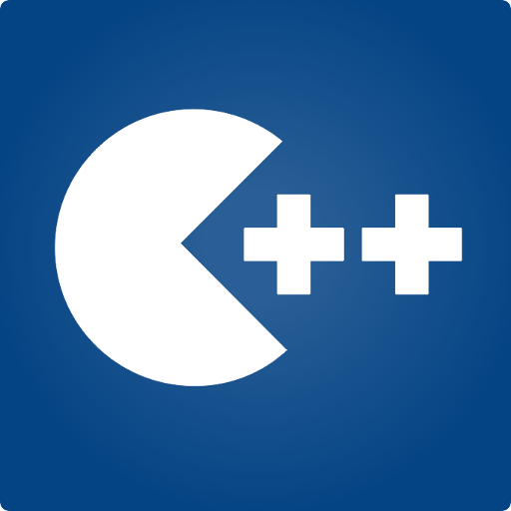
Programming Fundamentals
Taimur Sajjad
MS(Data Science)
MS(Mob. Computing)
Lecturer (Computer Science),,
CUI Wah Campus

Slide 2
Control Structures (Repetition)
Programming Fundamentals

Slide 3
Objectives
In this Lecture, you will:
Learn about repetition (looping) control structures
Explore how to construct and use counter-controlled and sentinel-controlled repetition structures
Examine break and continue statements
Discover how to form and use nested repetition structures

Slide 4
Why Is Repetition Needed?
Repetition statements allow us to execute statement/s multiple times
Often they are referred to as loops
Loops cause a section of your program to be repeated a certain number of times
Repeats until the condition remains true
Terminates when the condition becomes false

Slide 5
Loops
Counter-controlled Loops
Depends on the value of a variable known as counter variable. The value of the variable is incremented or decremented in each iteration.
Example: for loop
Sentinel-Controlled Loops / Conditional loop
A loop that terminates when something happens inside the loop body indicating that loop should be exited. Also known as conditional loops
Example: while and do loops

Slide 6
Types of Loops in C++
C++ have 3 types of Loops
The for loop
The while loop
The do while loop

Slide 7
Repetition
The for Loop

Slide 8
The for Loop (Syntax)
The initialization
is executed once
before the loop begins
The statement is
executed until the
condition becomes false
for ( initialization ; condition ; variable update ){
statement;
}
The variable update portion is executed at the end of each iteration

Slide 9
The for Loop
Initialization is done only once before first iteration of loop.
Can have multiple initialization statements
Can be used to declare a variable
Condition is checked in each iteration before executing the body ( block of code) of loop.
Increment / decrement or any expression written at statement 3 (variable update) is executed at the end of each Iteration
Can have multiple Statements

Slide 10
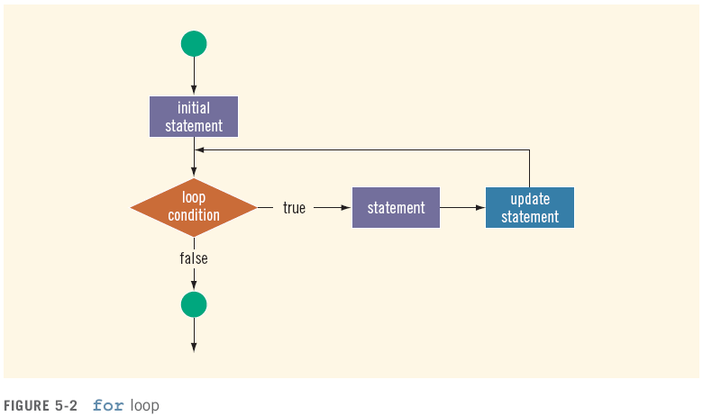
Logic of a for Loop (Flow Chart)

Slide 11
Simple Algo of for Loop
First step: In for loop, initialization happens first and only once, which means that the initialization part of for loop only executes once.
Second step: Condition in for loop is evaluated on each loop iteration, if the condition is true then the statements inside of for loop body gets executed. Once the condition returns false, the statements in for loop does not execute and the control gets transferred to the next statement in the program after for loop.
Third step: After every execution of for loop’s body, the increment/decrement part of for loop executes that updates the loop counter.
Fourth step: After third step, the control jumps to second step and condition is re-evaluated.
The steps from second to fourth repeats until the loop condition returns false.

Slide 12
An example of a for loop:
Problem Statement:
Write a program which displays “Hello world” on screen 10 times.

Slide 13
Solution 1 (without loop)
int main()
{
cout<<“Hello World”<<endl;
cout<<“Hello World”<<endl;
cout<<“Hello World”<<endl;
cout<<“Hello World”<<endl;
cout<<“Hello World”<<endl;
cout<<“Hello World”<<endl;
cout<<“Hello World”<<endl;
cout<<“Hello World”<<endl;
cout<<“Hello World”<<endl;
cout<<“Hello World”<<endl;
return 0;
}

Slide 14
Solution 2 (with for loop)
int main()
{
int i;
for( i=1; i<=10; i++)
{
cout<<“Hello World”<<endl;
}
return 0;
}

Slide 15
Another Example
int main(){
for(int i=1; i<=6; i++){
/* This statement would be executed
* repeatedly until the condition
* i<=6 returns false.
*/
cout<<"Value of variable i is: "<<i<<endl;
}
return 0;
}

Slide 16
Another Example
int main(){
for(int i=1; i<=6; i++){
/* This statement would be executed
* repeatedly until the condition
* i<=6 returns false.
*/
cout<<"Value of variable i is: "<<i<<endl;
}
return 0;
}
Output:
Value of variable i is: 1
Value of variable i is: 2
Value of variable i is: 3
Value of variable i is: 4
Value of variable i is: 5
Value of variable i is: 6

Slide 17
Infinite for loop
When it executes repeatedly and never stops
Cause:
When you set the condition in for loop in such a way that it never return false, it becomes infinite loop.
Example
int main(){
for(int i=1; i>=1; i++){
cout<<"Value of variable i is: "<<i<<endl;
}
return 0;
}
Notes:
This is an infinite loop as we are incrementing the value of i so it would always satisfy the condition i>=1, the condition would never return false.
Here is another example of infinite for loop:
// infinite loop for ( ; ; ) { // statement(s) }

Slide 18
for loop – Multiple Expressions
Multiple Initialization
expressions
Only one
Test Condition
Multiple Increment/Dec
expressions
for (int j=0, k=9; j<10; j++,k--)
{
cout << j * j <<endl;
cout<< k*k <<endl;
}

Slide 19
for loop – Scope of Variable
int main()
{
int j;
for(j=0; j<10; j++) {
int k=0;
k = j*j;
cout<<“\nValue of k: “<<k;
}
// k = 23; Cannot do this!
return 0;
}

Slide 20
The for Loop
Optional Expressions

Slide 21
The for Loop (Syntax)
The initialization
is executed once
before the loop begins
The statement is
executed until the
condition becomes false
for ( initialization ; condition ; variable update ){
statement;
}
The variable update portion is executed at the end of each iteration

Slide 22
for Loop – Optional Expression
Option 1
int j=0;
for(; j<10; j++)
cout<<“\nHello world“;
Option 2
int j;
for(j=0; j<10; )
{
cout<<“\nHello world“;
j++;
}
Output:
Hello world
Hello world
Hello world
Hello world
Hello world
Hello world
Hello world
Hello world
Hello world
Hello world
Option 3
int j=0;
for(; j<10; )
{
cout<<“\nHello world“;
j++;
}

Slide 23
for Loop – Optional Expression
Option 4
int j=0;
for(; ; )
{
cout<<“\nHello world“;
j++;
}
Infinite loop

Slide 24
break & continue
Used to alter the flow of control

Slide 25
The break statement
break statement is used for two purposes:
To exit early from a loop even if the loop condition is true
To skip the remainder of the switch structure
After the break statement executes, the program continues with the first statement after the structure

Slide 26
Using break
Option 4
int j=0;
for(; ; )
{
cout<<“\nHello world“;
j++;
}
Infinite loop
Option 4 (Corrected)
int j=0;
for(; ; )
{
if(j >= 10)
break;
cout<<“\nHello world“;
j++;
}
Output:
Hello world
Hello world
Hello world
Hello world
Hello world
Hello world
Hello world
Hello world
Hello world
Hello world

Slide 27
The continue Statement
continue is used in while, for, and do…while structures
When executed in a loop It skips remaining statements after the continue statement
Skips to the bottom of the loop
Update statement is executed in for loops
Condition check is evaluated in do…while loops

Slide 28
Continue example
int main()
{
int i;
for( i=0; i<10; i++)
{
cout<<“Hello World”<<endl;
continue;
cout<<“This line will never be executed”<<endl;
}
return 0;
}
Output:
Hello world
Hello world
Hello world
Hello world
Hello world
Hello world
Hello world
Hello world
Hello world
Hello world

Slide 29
Sum of +ve values entered by user
int v = -1, total = 0;
for(int i=1; i<=5; i++)
{
cout << "Enter a positive value " << endl;
cin >> v;
if (v < 0)
continue;
total = total + v;
}
cout<<"Total is "<<total;
Output:
Enter a positive value
1
Enter a positive value
2
Enter a positive value
3
Enter a positive value
-6
Enter a positive value
-7
Total is 6
Notes:
//Sum of +ve values entered by user

Slide 30
The for Loop (Summary)
A for loop is well suited for executing statements a specific number of times that can be calculated or determined in advance
Each expression in the header of a for loop is optional
If the initialization is left out, no initialization is performed
If the condition is left out, it is always considered to be true, and therefore creates an infinite loop .Use break statement.
If the increment is left out, no increment operation is performed

